Slide 1

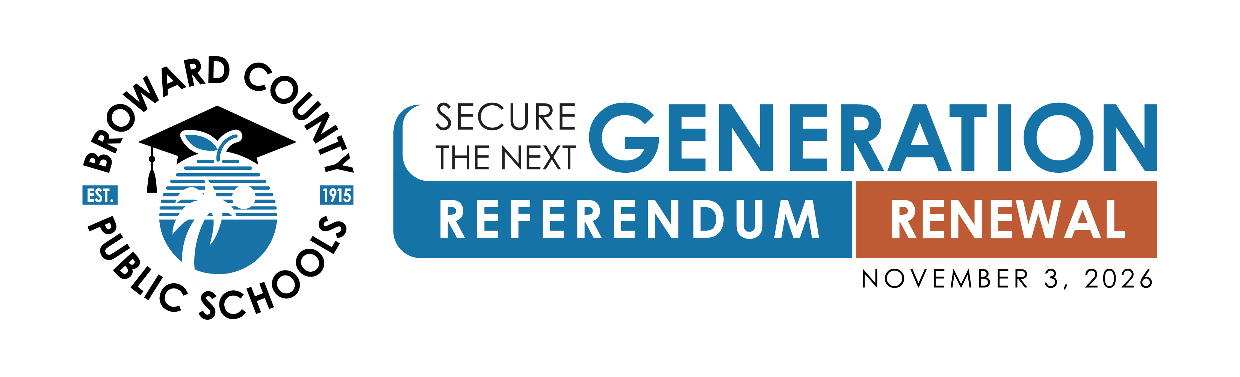




A renewal of the existing one-mill property tax
BCPS NORTH AREA
ADVISORY COMMITTEE
For Informational Purposes Only

Slide 2
Before We Begin
This presentation is informational only.
Broward County Public Schools shares facts about the Secure The Next Generation Referendum renewal. District employees educate – they do not advocate for or against the ballot measure.
A renewal of the existing one-mill property tax
For Informational Purposes Only
Notes:
Read this slide directly after the welcome, before moving into District highlights. State plainly: this presentation shares information only. Broward County Public Schools, in an official capacity, educates the public about ballot measures but does not advocate for or against a particular vote.
This sets the tone for the entire presentation and should not be rushed – it is the legal basis for everything that follows.

Slide 3
Broward County Public Schools Highlights
“A” Rated District for third consecutive year
No D or F Schools for third consecutive year
First time since 1999
Highest Graduation Rate in 25 Years
97.5% (traditional HS) and 91.4% (all schools)
Cambridge District of the Year for 2025/26
#1 in Funding in Florida for AP, AICE, Dual Enrollment and Industry Certifications
A renewal of the existing one-mill property tax
For Informational Purposes Only
3

Slide 4
About Us
236,667
Total Students Enrolled
325
Total Schools (incl. 86 charters)
27,848
Total Employees
$617 Million
In Scholarships & Financial Aid, Class of 2026
Student Demographics
Group | Percent | Count of Students
Race
White | 50.5% | 119,594
Black | 40.9% | 96,748
Asian | 3.9% | 9,265
Native American / Alaskan | 0.3% | 689
Native Hawaiian / Pacific Islander | 0.2% | 495
Multiracial | 4.2% | 9,876
Ethnicity
Hispanic | 39.5% | 93,427
Non-Hispanic | 60.5% | 143,240
Source: BCPS About Us 2026/27; 09/08/2025 Benchmark Day Enrollment Report, Demographics & Enrollment Planning
A renewal of the existing one-mill property tax
For Informational Purposes Only
4
Notes:
This slide gives the Commission a fuller picture of the District beyond this referendum: total enrollment, total schools, workforce size, and scholarship dollars earned by the graduating class.
The demographics table is for context and transparency, not persuasion – present the numbers plainly and move on unless there are specific questions.
Figures are drawn from the District's official About Us 2026/27 fact sheet and the most recent Benchmark Day Enrollment Report.

Slide 5
District School Grades
Triple A: Rated “A” for Three Consecutive Years
A
2023-24
A
2024-25
A
2025-26
School Grade Count — District Operated Schools
School Year | A | B | C | D | F
2025-26 | 129 | 56 | 27 | 0 | 0
2024-25 | 110 | 69 | 34 | 0 | 0
2023-24 | 82 | 61 | 70 | 0 | 0
2022-23 | 56 | 46 | 99 | 11 | 1
Source: 2025-26 School Grades, FLDOE, as of July 1, 2026
A renewal of the existing one-mill property tax
For Informational Purposes Only
5
Notes:
This is the district-wide grade trend, shown before the Davie-specific grades on the next two slides – it establishes the broader context first.
Lead with the headline: the District has earned an A for three consecutive years – 2023-24, 2024-25, and 2025-26. This is the strongest version of this story, so give it a beat before moving into the detailed table.
The table below breaks out how many District-operated schools earned each letter grade in each of the last four years. Note the trend line if asked: A-rated schools have grown from 56 (2022-23) to 129 (2025-26), while D and F schools have dropped to zero since 2023-24.

Slide 6
District School Grades
Triple A: Rated “A” for Three Consecutive Years
A
2023-24
A
2024-25
A
2025-26
School Grade Count — District Operated Schools
School Year | A | B | C | D | F
2025-26 | 129 | 56 | 27 | 0 | 0
2024-25 | 110 | 69 | 34 | 0 | 0
2023-24 | 82 | 61 | 70 | 0 | 0
2022-23 | 56 | 46 | 99 | 11 | 1
Source: 2025-26 School Grades, FLDOE, as of July 1, 2026
A renewal of the existing one-mill property tax
For Informational Purposes Only
6
Notes:
This is the district-wide grade trend, shown before the Davie-specific grades on the next two slides – it establishes the broader context first.
Lead with the headline: the District has earned an A for three consecutive years – 2023-24, 2024-25, and 2025-26. This is the strongest version of this story, so give it a beat before moving into the detailed table.
The table below breaks out how many District-operated schools earned each letter grade in each of the last four years. Note the trend line if asked: A-rated schools have grown from 56 (2022-23) to 129 (2025-26), while D and F schools have dropped to zero since 2023-24.

Slide 7
At a Glance
Election Date
November 3, 2026 — General Election
What It Is
A renewal of the existing one-mill property tax — not a new tax
Duration
Four school years beginning with the 2027/28 school year
Annual Revenue
Approximately $358 million across all Broward public schools, including charter schools
What It Funds
Teacher and staff compensation supplements, school safety personnel, and mental health professionals
A renewal of the existing one-mill property tax
For Informational Purposes Only
7

Slide 8
What It Is?
A renewal of the existing one-mill property tax — not a new tax
A renewal of the existing one-mill property tax
For Informational Purposes Only
8

Slide 9
What It Funds / What These Funds Support Today
The Secure The Next Generation Referendum renewal would continue funding for all Broward County public schools — including charter schools — to:
The current Secure the Next Generation Referendum, approved by voters in 2022, is set to expire. Those funds currently support:
Recruit and retain high-quality teachers and eligible staff by continuing compensation supplements
Maintain and enhance School Resource Officers (SROs) and school safety staff
Maintain and enhance essential programs, such as mental health services for students and families
Approximately $173 million annually in compensation supplements for teachers and eligible staff
Over 393 school safety personnel and $1.7 million in state-of-the-art software providing all staff with wearable panic-buttons for immediate security response
More than 224 mental health professionals
A renewal of the existing one-mill property tax
For Informational Purposes Only
9

Slide 10
Bond vs. Referendum: What’s the Difference?
Both raise money for schools — but in very different ways
 | Bond | Referendum
What It Is | A loan the District borrows and agrees to repay over time, similar to a mortgage. | A voter-approved property tax rate (millage) that generates revenue each year.
How Voters Approve It | Voters authorize the District to borrow a specific dollar amount. | Voters authorize a specific millage rate for a set number of years.
What It Can Fund | One-time capital costs, such as construction, renovations and technology infrastructure. | Recurring operating costs, such as compensation, school safety personnel and mental health professionals.
Repayment | Repaid over many years, typically with interest, like a loan. | Not repaid as debt — funds are collected and spent annually; the millage expires if not renewed.
In Broward County | The SMART Bond program funded school construction and renovation projects. | The current Referendum funds teacher and staff compensation, school safety and mental health services.
The SMART Bond program and the Next Generation Referendum are separate initiatives that fund different District priorities.
A renewal of the existing one-mill property tax
For Informational Purposes Only
10

Slide 11
Official Ballot Language
Fund School Employee Pay, Safety, and Mental Health through a One-Mill Property Tax Levy
To enhance school safety and mental health services, recruit and retain highly qualified teachers and essential employees, improve student achievement, and support critical school operations, shall the School Board of Broward County continue to levy a one-mill ad valorem property tax from January 1, 2027, through December 31, 2030, to fund school safety personnel, mental health services, increased compensation for teachers, and school-based support staff for public and charter schools?
A renewal of the existing one-mill property tax
For Informational Purposes Only
11

Slide 12
How will referendum funds be allocated, and who decides?
The School Board of Broward County, FL, retains the authority to vote on the allocation of referendum funds each year through its formal budget adoption process. The public will have an opportunity to comment on the allocation of funds prior to distribution.
The referendum renewal would continue securing funds for all public schools — including charter schools — to:
90% or more
Up to 10%
to provide compensation supplements to recruit and retain teachers and eligible staff
to provide funding for school resource officers and school safety staff, and to preserve important programs, such as mental health services and personnel
All compensation will be subject to collective bargaining. These funds will not be available until the 2027/28 school year.
A renewal of the existing one-mill property tax
For Informational Purposes Only
12

Slide 13
Cost Savings Measures
Before asking voters to renew dedicated Secure The Next Generation Referendum renewal funding, the District has worked to reduce costs elsewhere in its General Fund budget – separate from the compensation, safety and mental health positions this referendum protects.
1,000
$54M
$46M
7
$100M+
Positions Reduced
Est. Recurring Savings
Health Plan Savings
Schools Closed
Total Estimated Savings
$26M in General Fund savings
Annual, redesigned plan model
Campus consolidations completed
$54M + $46M combined
Please note: The remaining roles have fixed workloads, and services are more likely to be affected if further reductions are needed. Every projected saving is verified before being counted toward future budgets.
A renewal of the existing one-mill property tax
For Informational Purposes Only
13

Slide 14
What Is a Mill / Cost to Property Owners ?
The mill or millage rate is the amount of property value used to calculate local property taxes. One mill equals $1 in taxes for every $1,000 of taxable property value (or $100 per $100,000).
$418 - home
$230 - condominium
$358M
per year / $35 per month
per year / $19 per month
generated annually
The average homeowner with a home market value of $652,756 and a School Board taxable value of $417,877, would invest approximately $418 that year or $35 per month, similar to what they currently invest.*
The average condo owner with a condo market value of $296,524 and a School Board taxable value of approximately $230,002, would invest approximately $230 that year or $19 per month, similar to what they currently invest.*
If approved by voters, the referendum would generate approximately $358 million annually — including $283 million for District-operated schools and $75 million for charter schools. The referendum renewal would cover four school years beginning with the 2027/28 school year.
*A homeowner's/condo owner's investment varies based on their School Board taxable value as determined by the Broward County Property Appraiser and may be subject to change annually.
A renewal of the existing one-mill property tax
For Informational Purposes Only
14

Slide 15

If Not Renewed
$358 million
The District would lose approximately $358 million annually currently funding safety and mental health positions and supplements.
A renewal of the existing one-mill property tax
For Informational Purposes Only
15

Slide 16
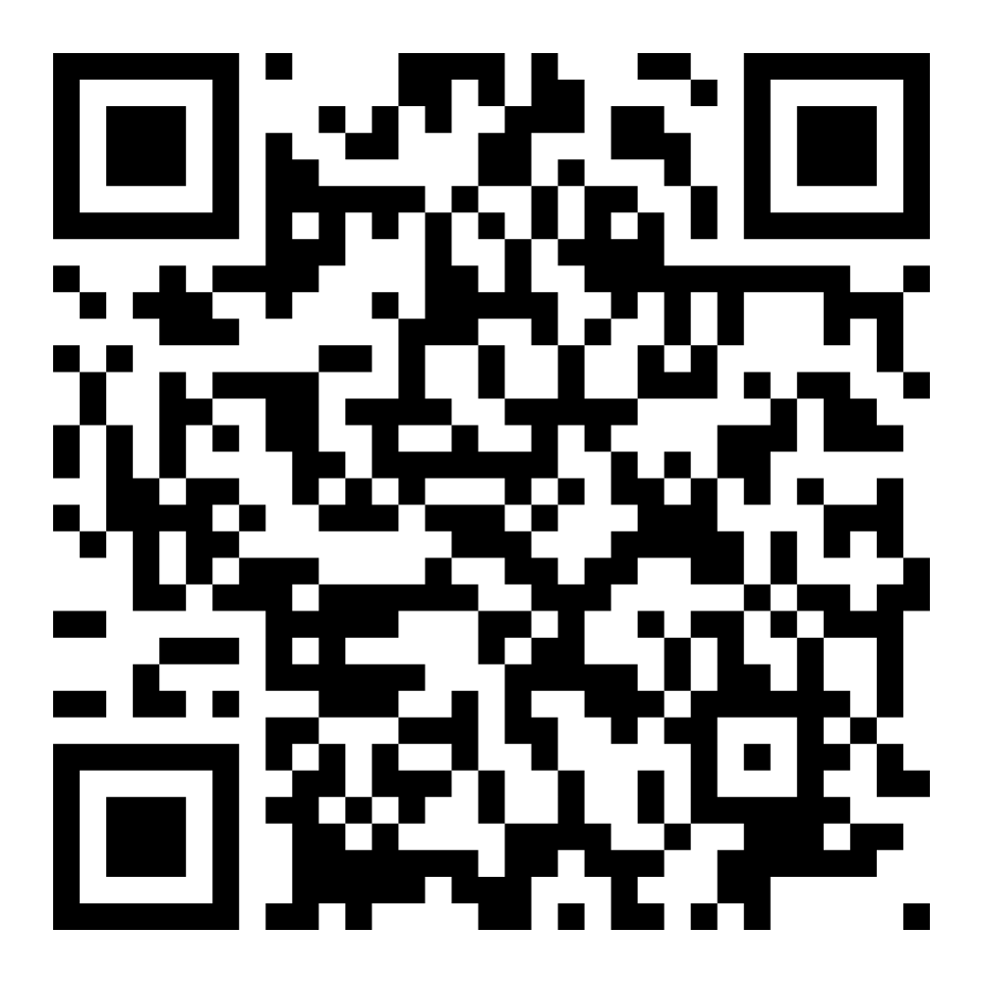
Learn More About the Secure The Next Generation Referendum
SCAN TO LEARN MORE
Visit Online
browardschools.com/referendum2026
Scan the QR code or visit the website above for information about the Next Generation Referendum, including official ballot language, FAQs, and where to find your voting location.
A renewal of the existing one-mill property tax
For Informational Purposes Only
16

